Slide 1




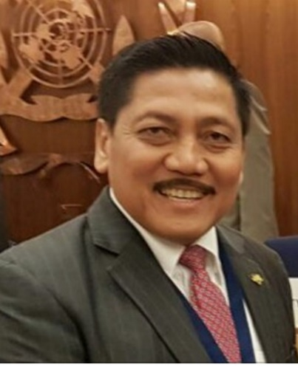
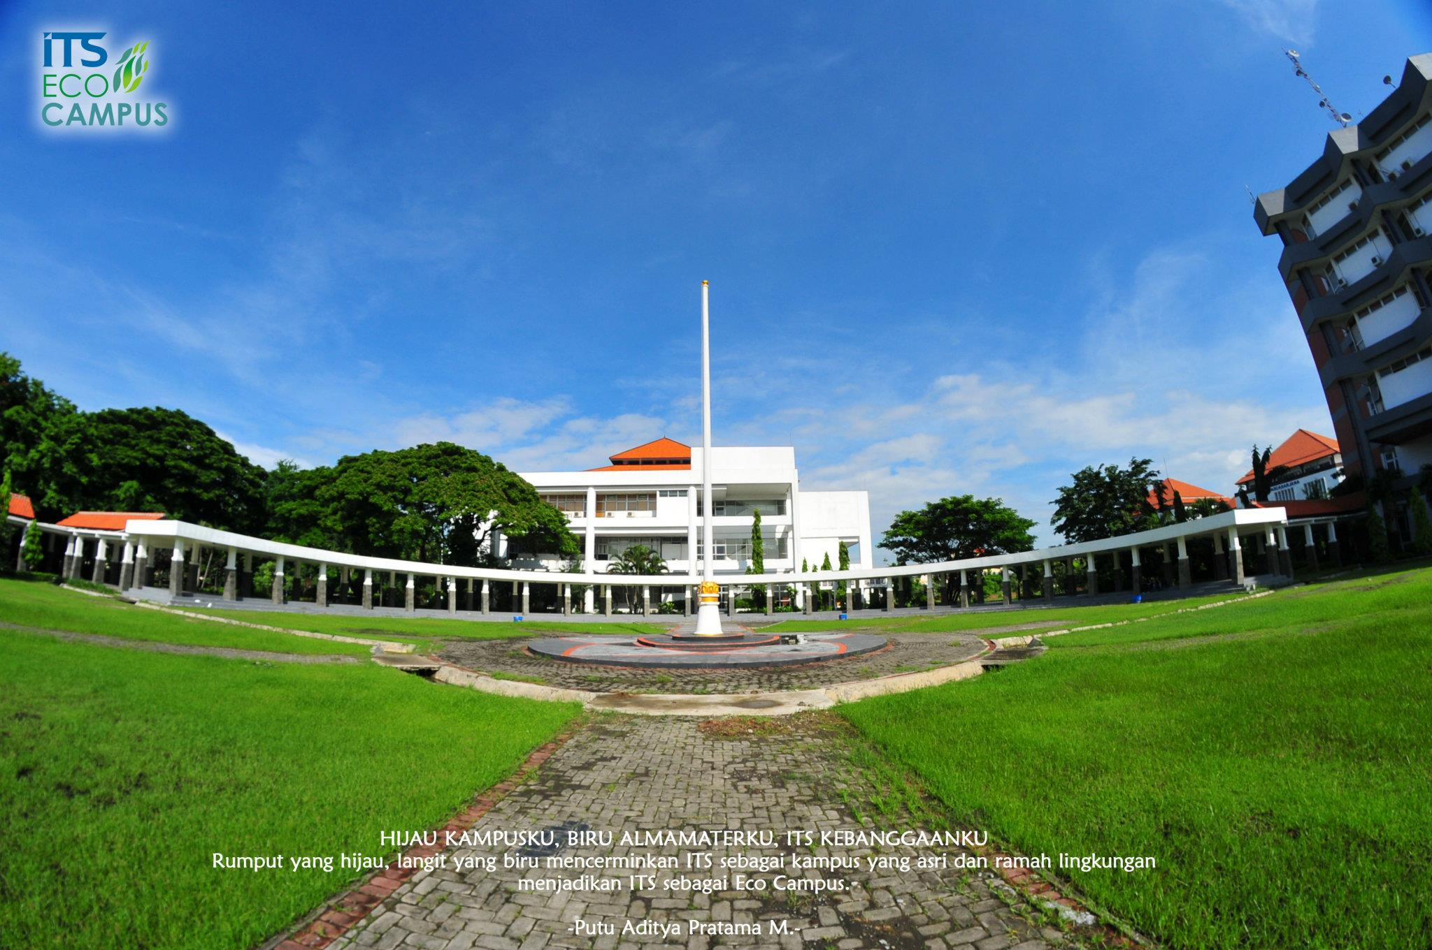
Primary Speech
SIDI International Conference 2019
Admiral ( Ret ) Prof . Dr. Marsetio
Expert Staff to the Minister of Tourism
Presented in
SIDI International Conference 2019
Surabaya, September 2nd, 2019

Slide 2

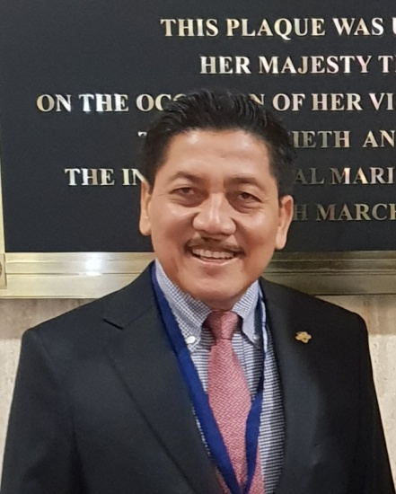
Name: Admiral ( Ret ) Prof . Dr. Marsetio
Defense Science Professor at Indonesia Defense University
NIDN:4703125601
Last education
Doctoral Program from Gajah Mada University
Military Education
Indonesian Naval Academy 26/1981 (Adhi Makayasa Recipient )
Operation School ( Netherlands,1986)
ISC Royal Naval College(UK,1991)
Naval Command and Staff College XXXIV/1996 (Dharma Wiratama Recipient )
Indonesian Armed Forces Command and Staff College XXVIII/2001(Best Graduate)
Naval Operation Course (Italy , 2002)
National Resilience Institute 37/2004 (Wibawa Seroja Nugraha Recipient )
Senior Executive Course/APCSS (Hawaii , the U. S.,2007)
Harvard Kennedy School , Boston,the U. S.,2014
Previous Positions
Commander , Tanjung Pinang Main Naval Base
Deputy Assistant for Operations to the TNI Chief
Commander , Military Sealift Command
Commander, Western Fleet Command,
Vice Chief of Navy
Chief of Navy
Academic Experience
Visiting Professor at Naval Postgraduate School , Monterey , the U. S.
Speakers in national and international seminars
Lecturer at National Resilience Institute
Lecturer at Indonesian Armed Forces Command and Staff College, Service Command and Staff College, and Staff and Leadership School , Ministry of Foreign Affairs.
Lecturer at Indonesia Defense University
Lecturer at Public and Private Universities
Current Positions
Special Envoy to IMO in London
Senior Adviser to the Coordinating Minister for Maritime Affairs
Expert Staff to the Minister of Tourism
Chairman of the Board, Indonesian Classification Bureau(BKI )
Chairman of the Development Acceleration Team for Central Kalimantan ( candidate for Indonesia’s Capital City )

Slide 3
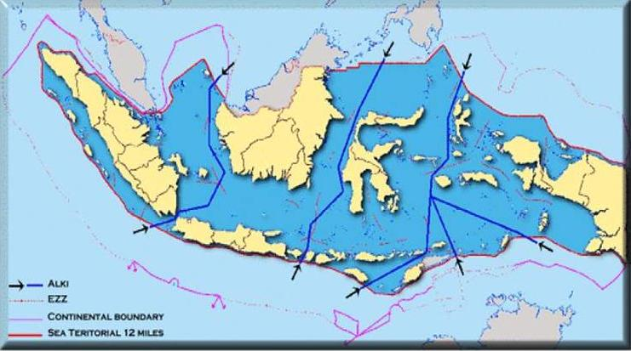
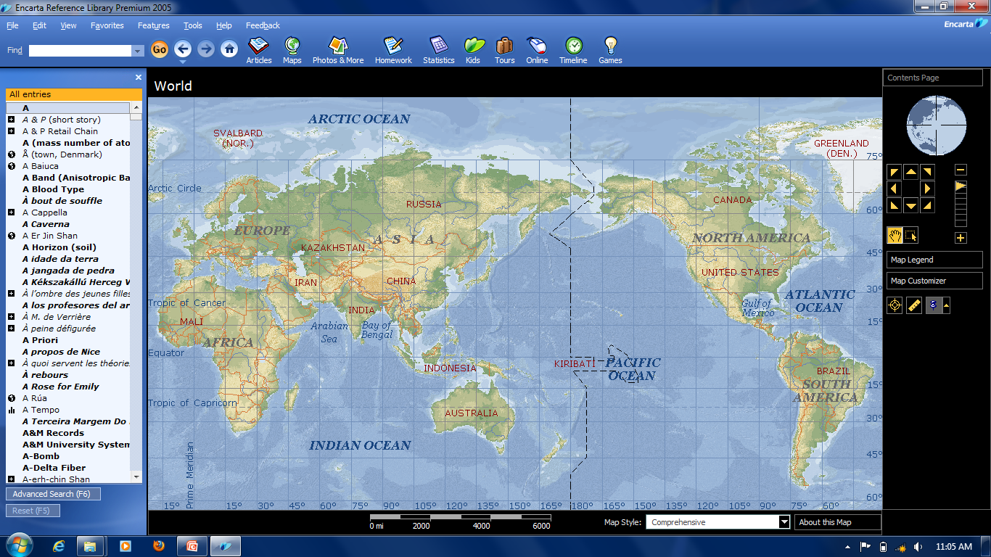
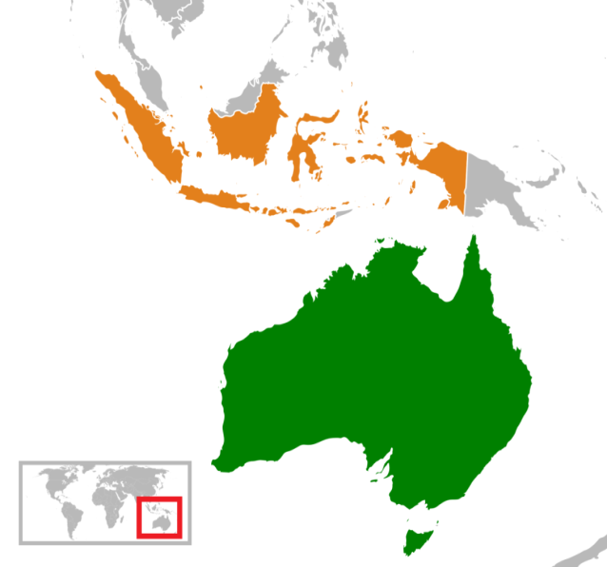
Indonesia is an archipelagic state
17,499 islands
A coastline of 81,000 kilometers
Waters of 5,9 million square kilometers.
Strategic geographical location (between the Indian and Pacific Oceans and between the Asia and Australia continents)
5150 km
If compared to the map of the United States, Indonesia stretches perfectly covering the West and the East Coasts

Slide 4
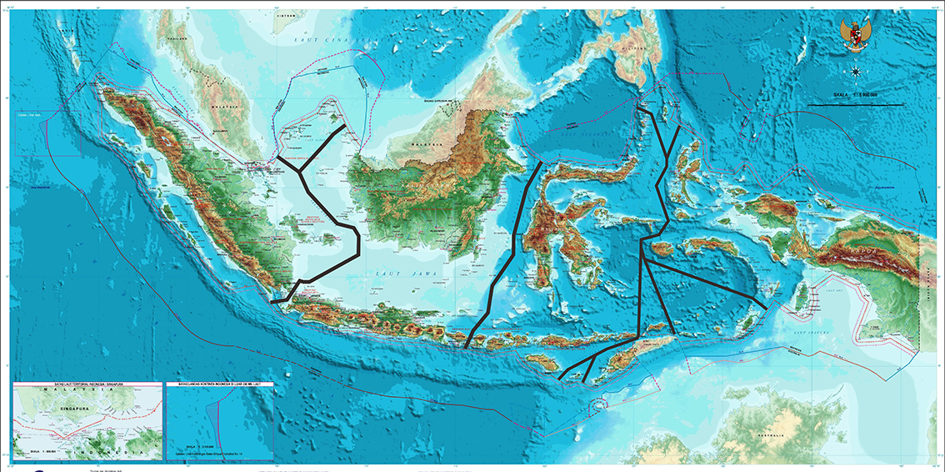






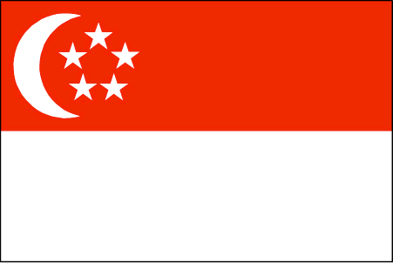

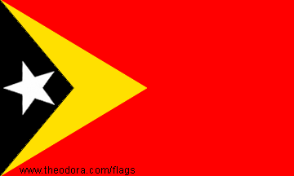


Indonesia has maritime boundaries with 10 countries
INDIA
THAILAND
VIETNAM
PHILIPINA
MALAYSIA
PALAU
SINGAPURA
PNG
RDTL
AUSTRALIA
4

Slide 5
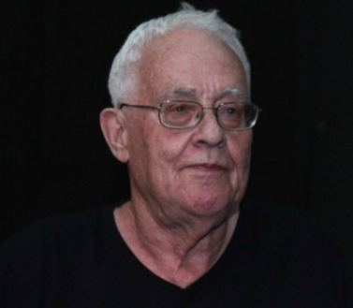

Benedict Anderson
Theory of Ball Lights
DEVELOPMENT RESULTS JUST TASTE BY THE CENTER,
THE REMOTE AREA FROM THE CENTER OF POWER NOT YET

Slide 6
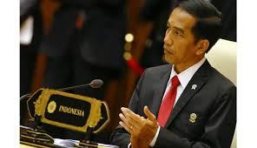
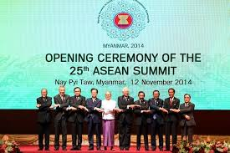
5 PILLARS OF MARITIME POLICY
1
MARITIME CULTURE
2
MARITIME RESOURCE
3
INFRASTRUCTURE & MARITIME CONECTIVITY
4
MARITIME DIPLOMACY
5
MARITIME DEFENCE

Slide 7
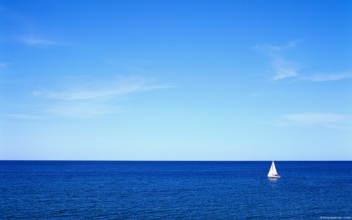
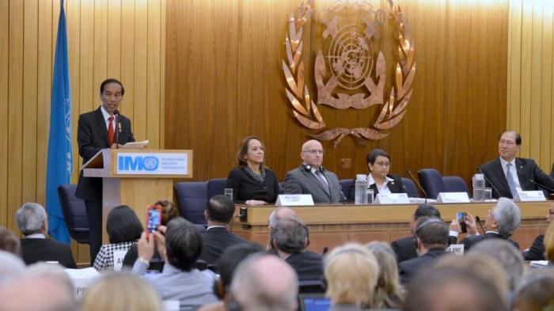
President Jokowi at IMO Forum:
I’m Committed to Making Indonesia Global Maritime Fulcrum
The administration that he leads, the President added, is committed to making Indonesia a Global Maritime Fulcrum, restoring the motto Jalesveva Jayamahe
(At sea we are victorious) and returning to the identity of the country as a maritime nation.
President Joko Widodo delivers his remarks at the building of the International Maritime Organization (IMO) in London, the United Kingdom, 19 April 2016

Slide 8
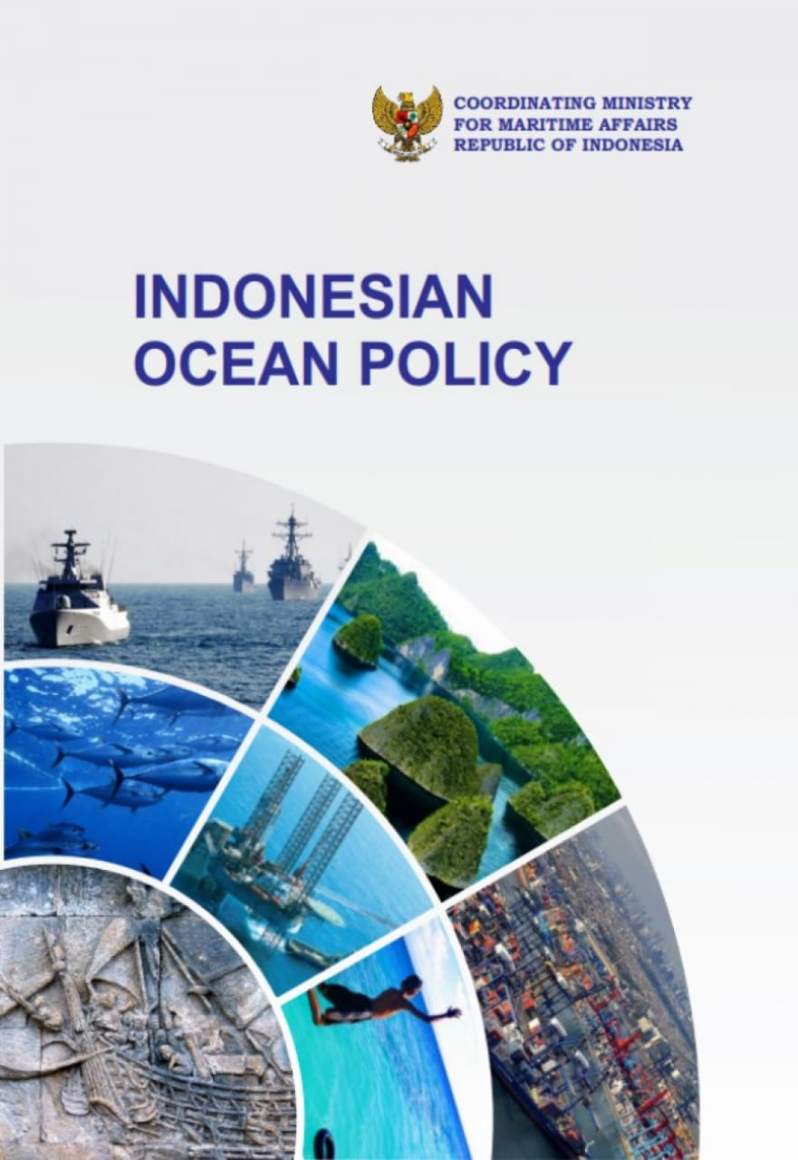
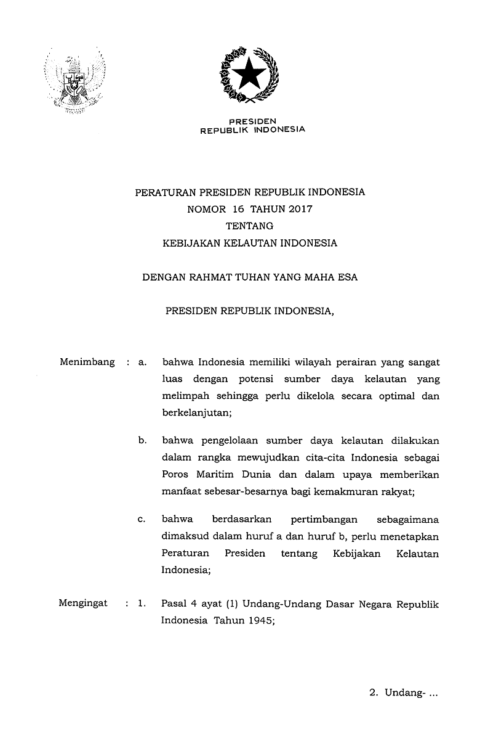
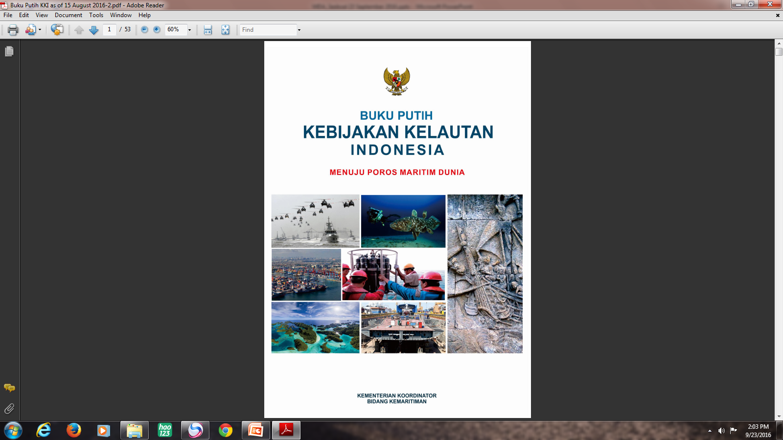
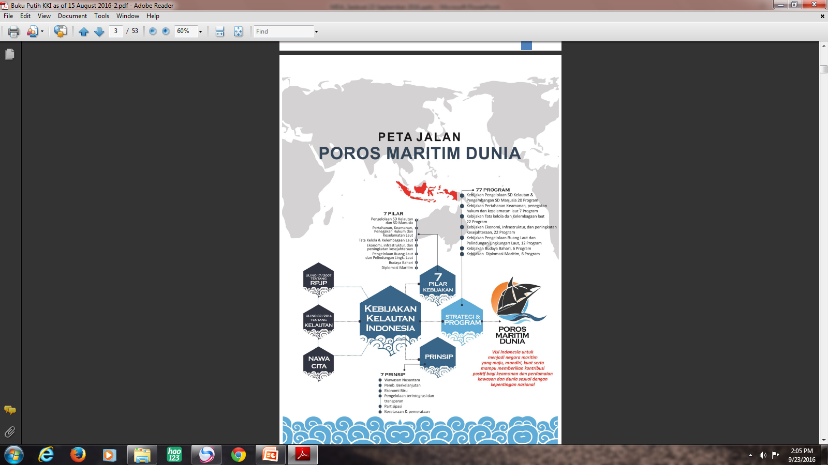
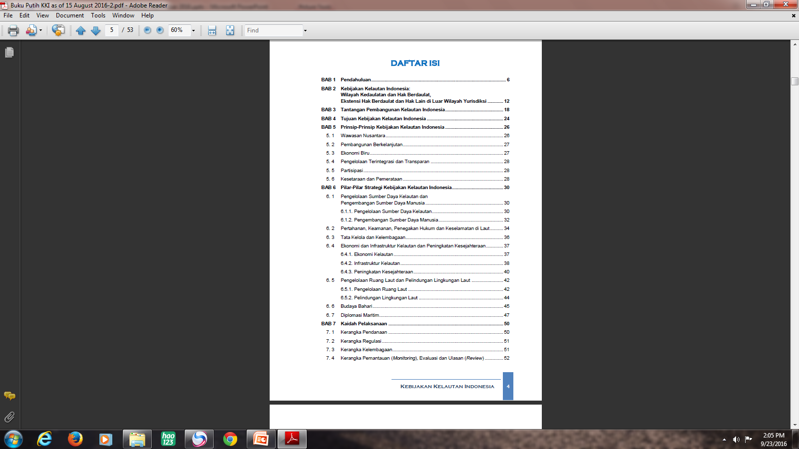
INDONESIAN OCEAN POLICY
PERPRES NO. 16 TAHUN 2017

Slide 9
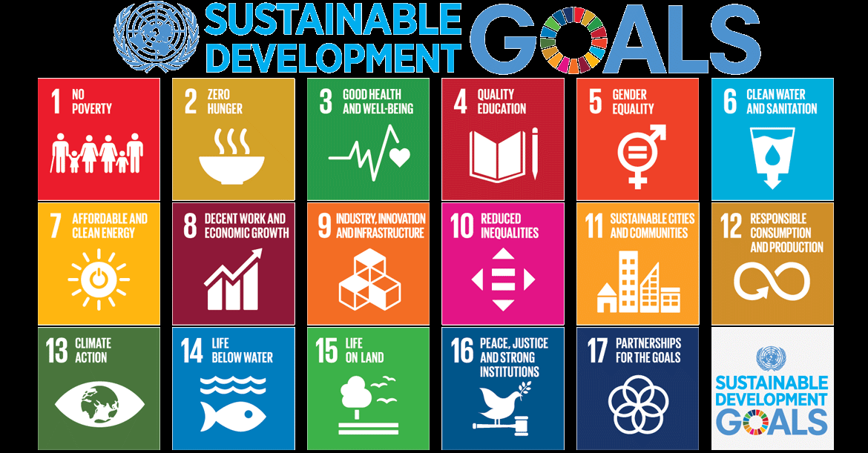

Slide 10

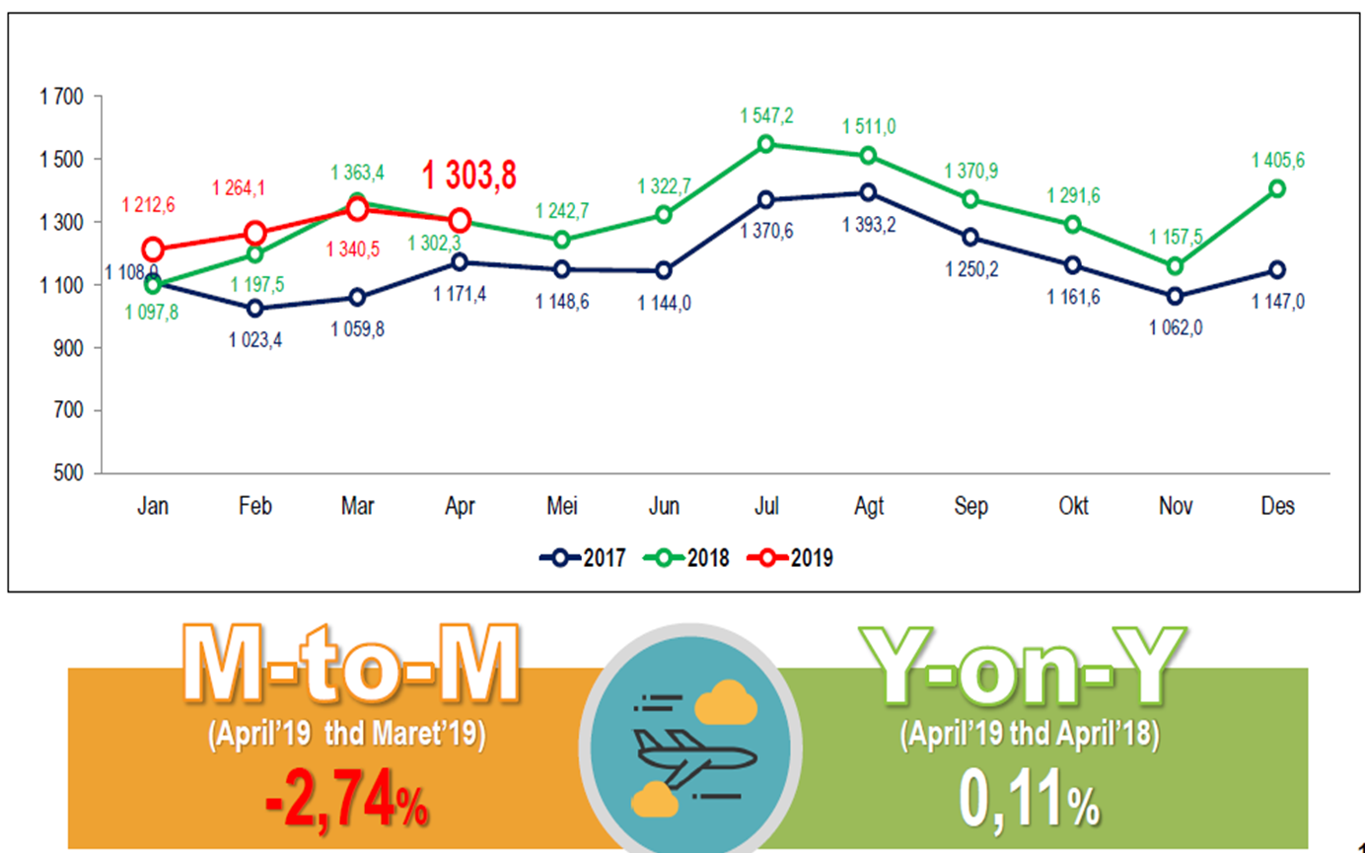
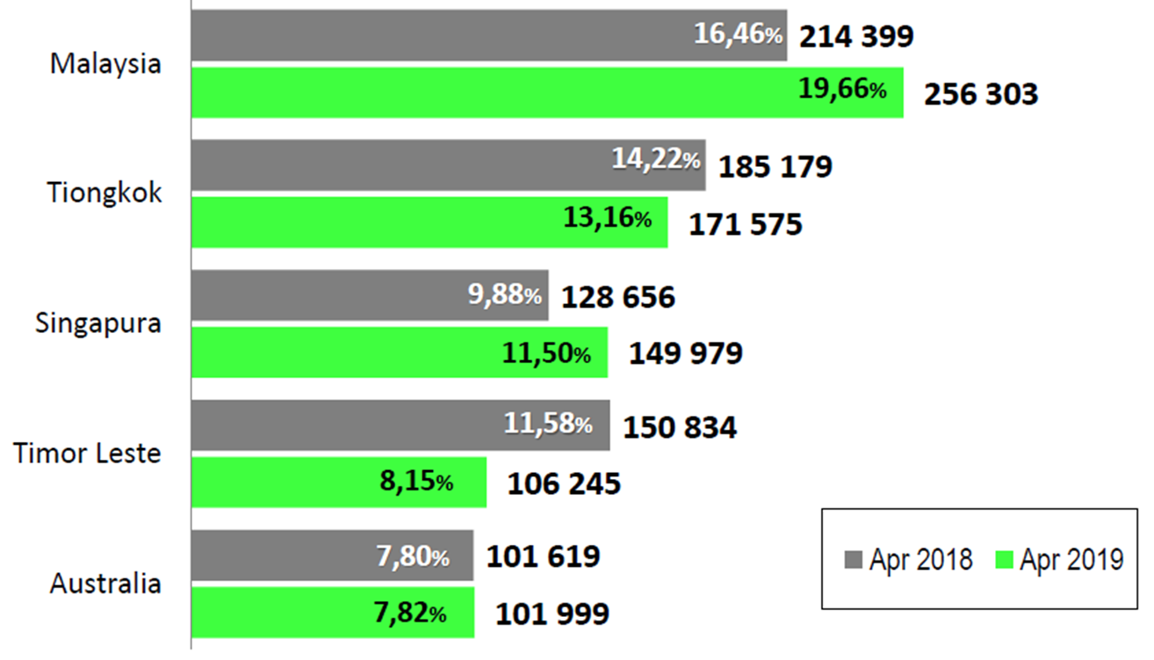
The development of foreign tourists
(2017 – 2019)
foreign tourists visiting Indonesia
according to nationality
Chinese
Singapore

Slide 13
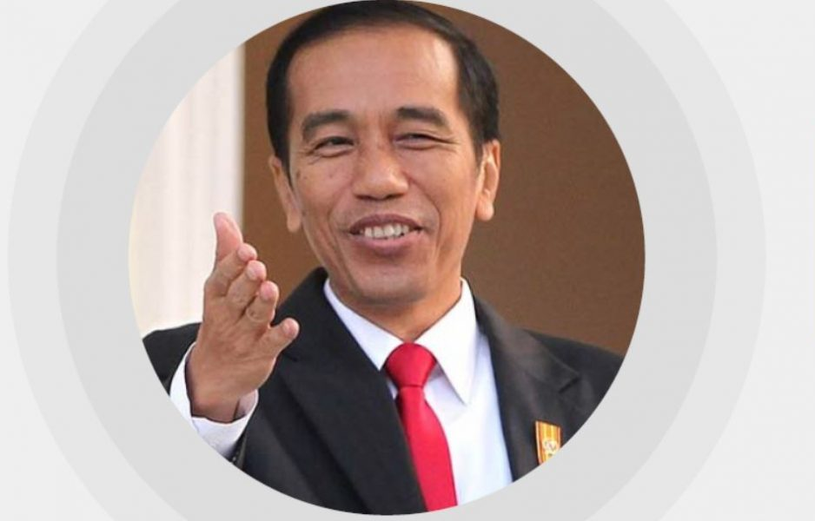
Indonesia Vision 2019-2024
The Presidential vision and mission for 2019-2024
at Sentul convention center in Bogor, Indonesia on July 14, 2019
There are five key inter-related subject that will be the government’s main focus of attention in Joko Widodo’s second period:
Reforming the bureaucracy
Infrastructure development
Investment realization
Development of human capital
More efficient us of the state budget

Slide 14
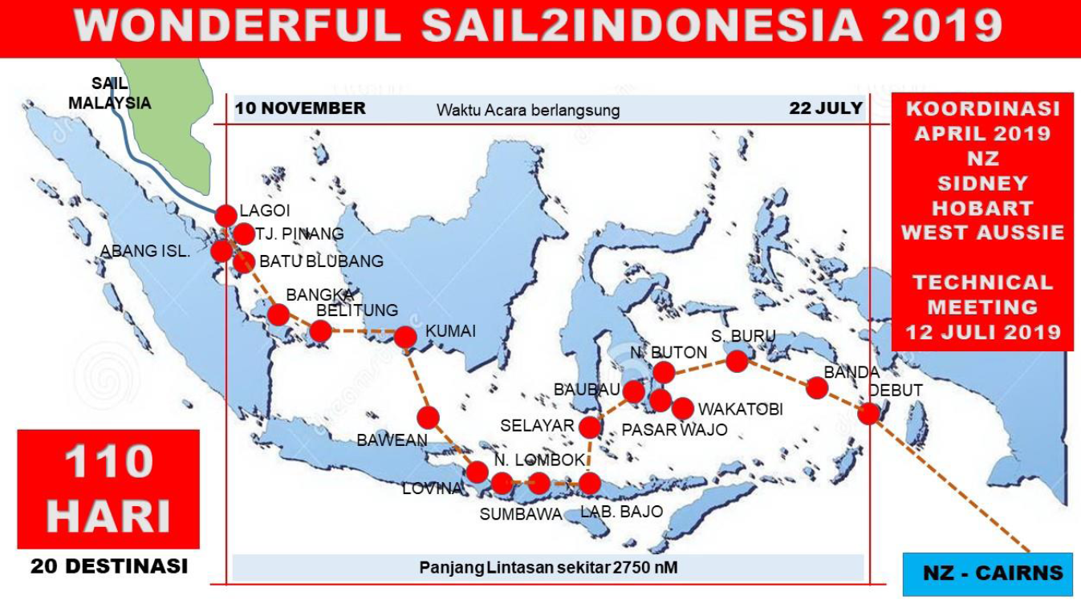

Slide 15
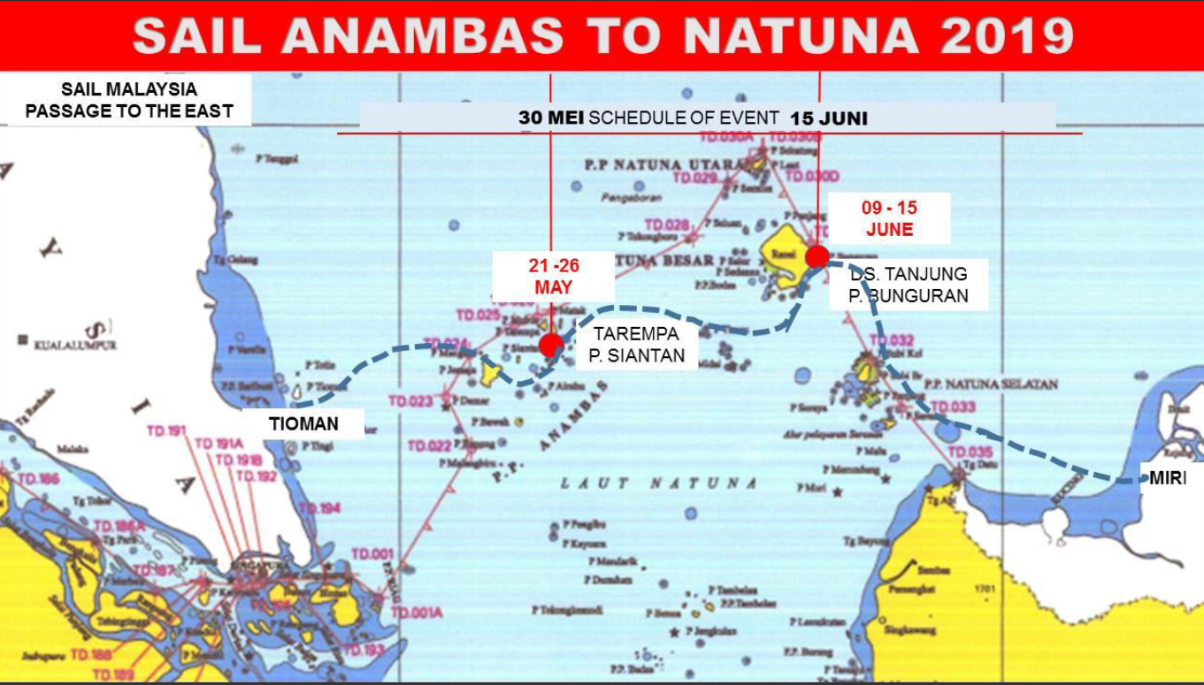

Slide 16
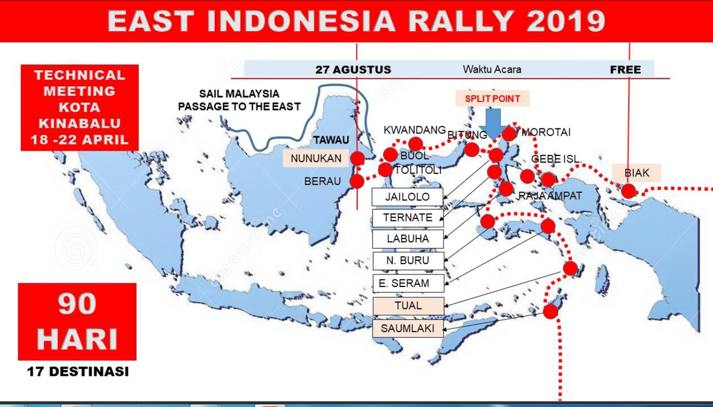

Slide 17
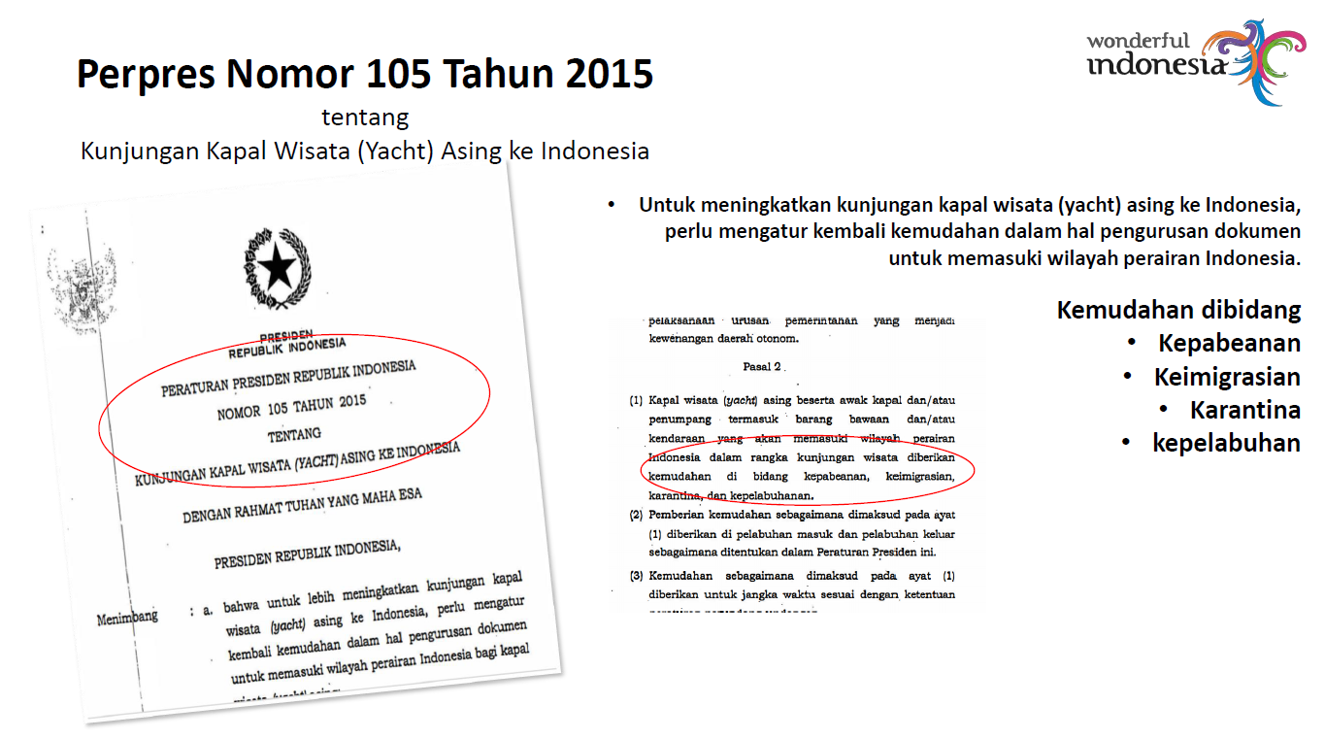

Slide 18
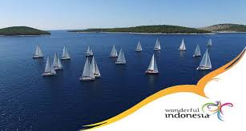
Evaluasi Wonderful Sail To Indonesia 2019
1. Inviting Yachts come to Indonesia.
2. Presidential Decree 105/2015
3. Ease Regulations, pre Entry Documentation, on line system, for Persin and Vessel.
4. Stated 21 Entry and Exit for viait8ng Yachts
5. 169 countries FREE Visa
6. More than 200 stop points have been visited by yachts
7. We have Yacht Rallies circumnavigating all over Indonesia.
8. We have beautiful People. Culture and Nature.

Slide 19
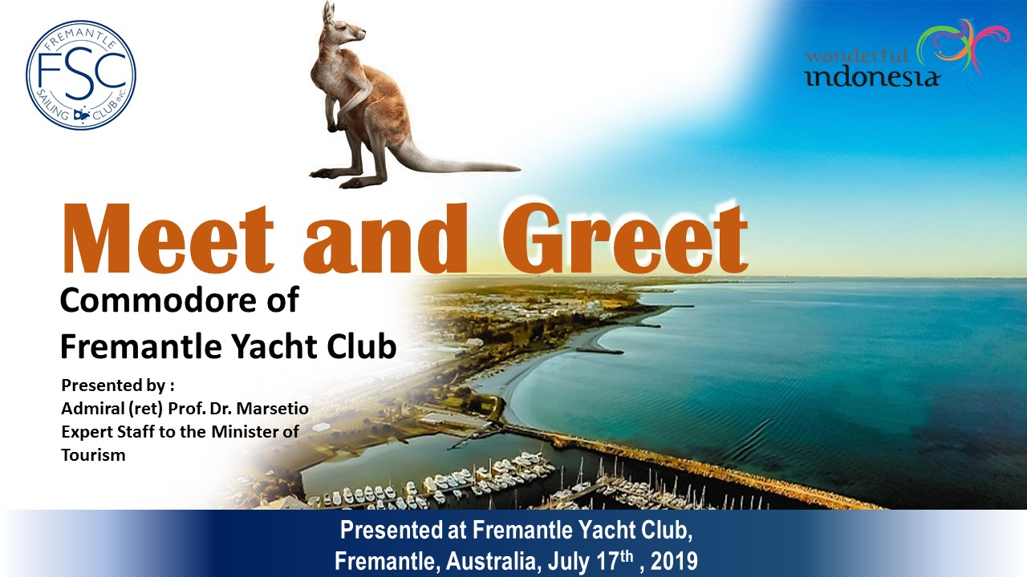

Slide 20
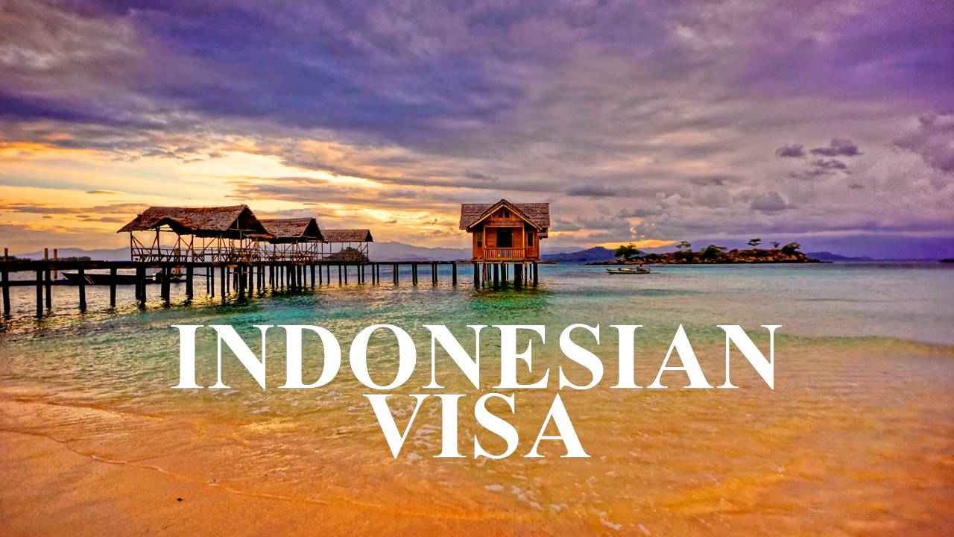

Slide 21
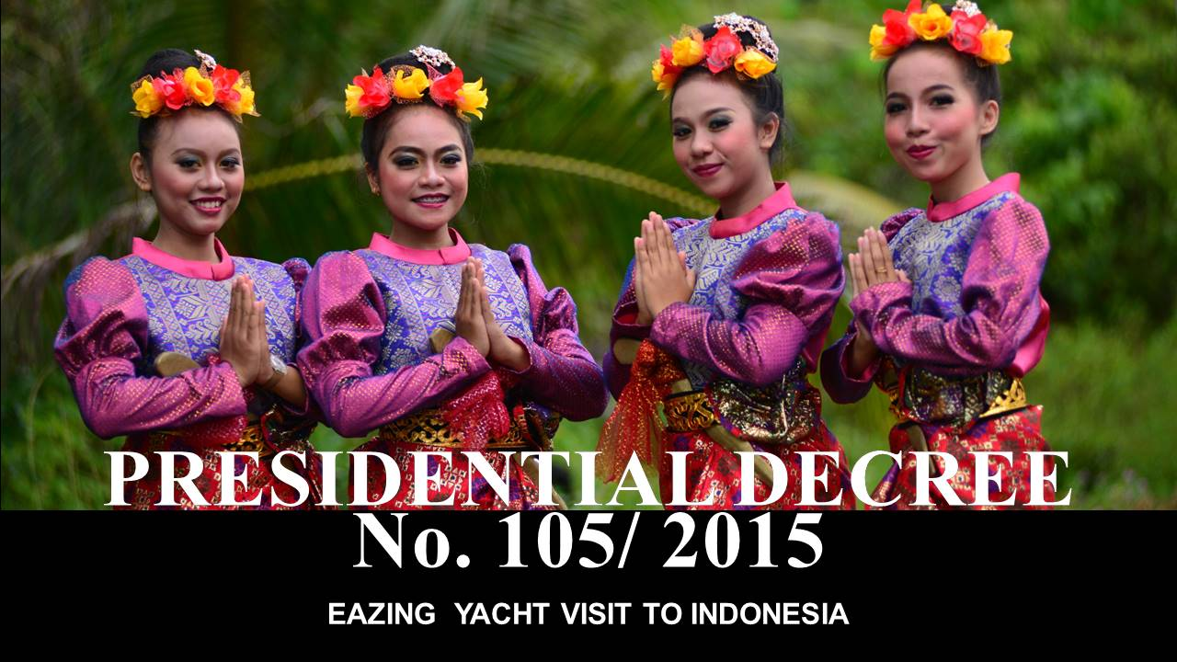

Slide 22
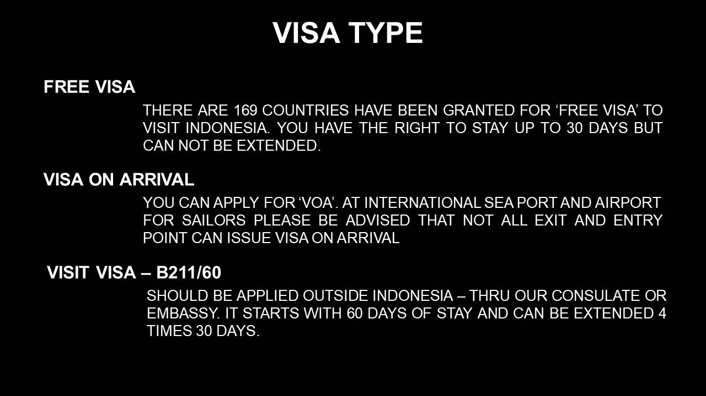

Slide 23
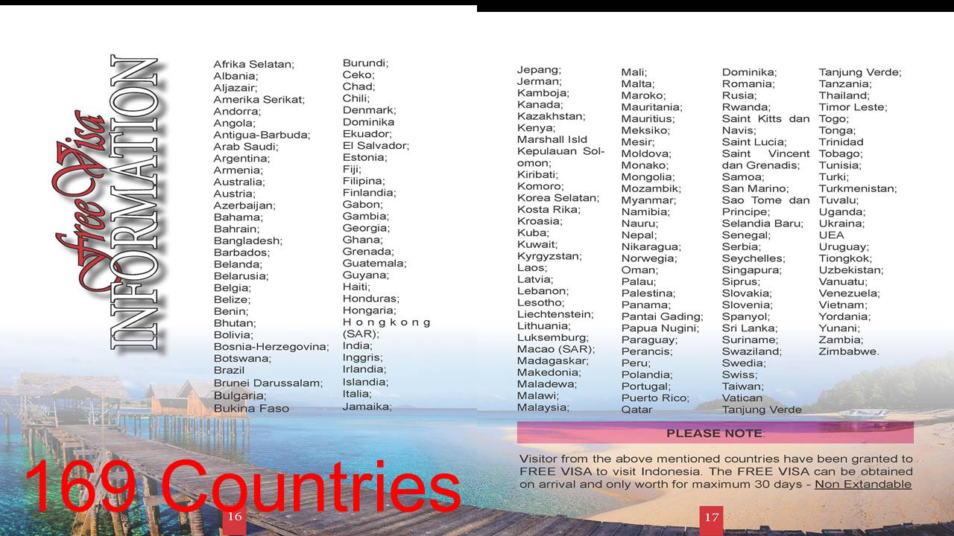

Slide 24
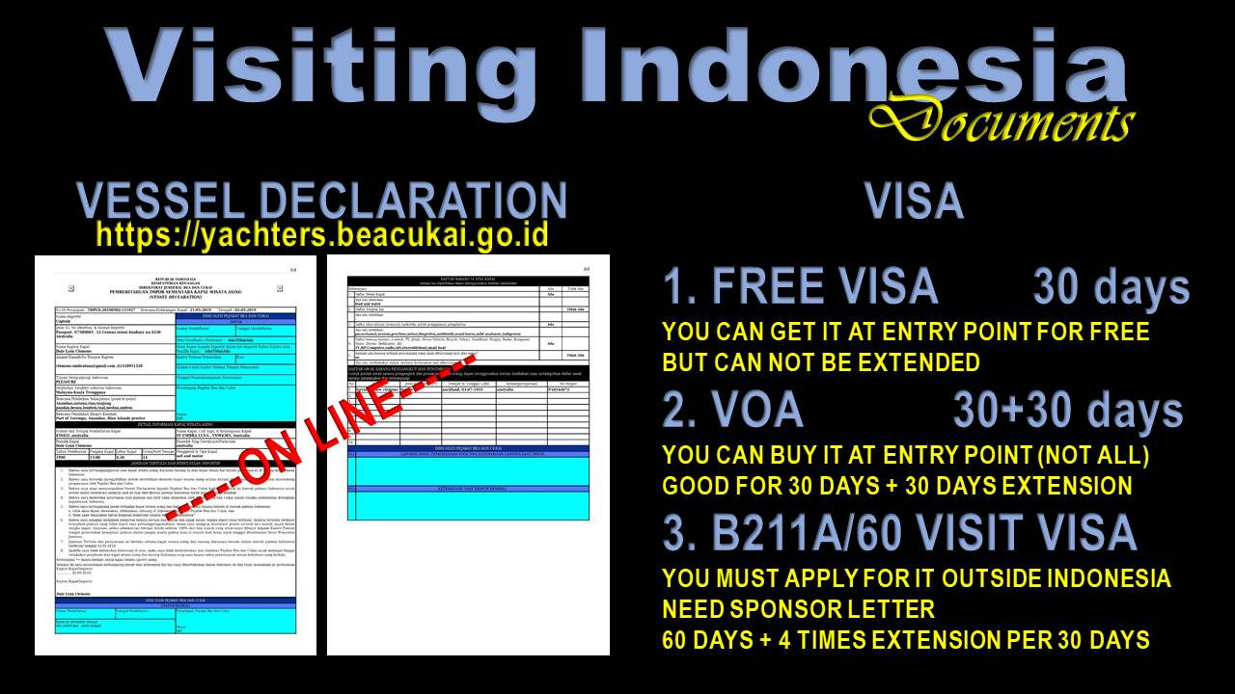

Slide 25
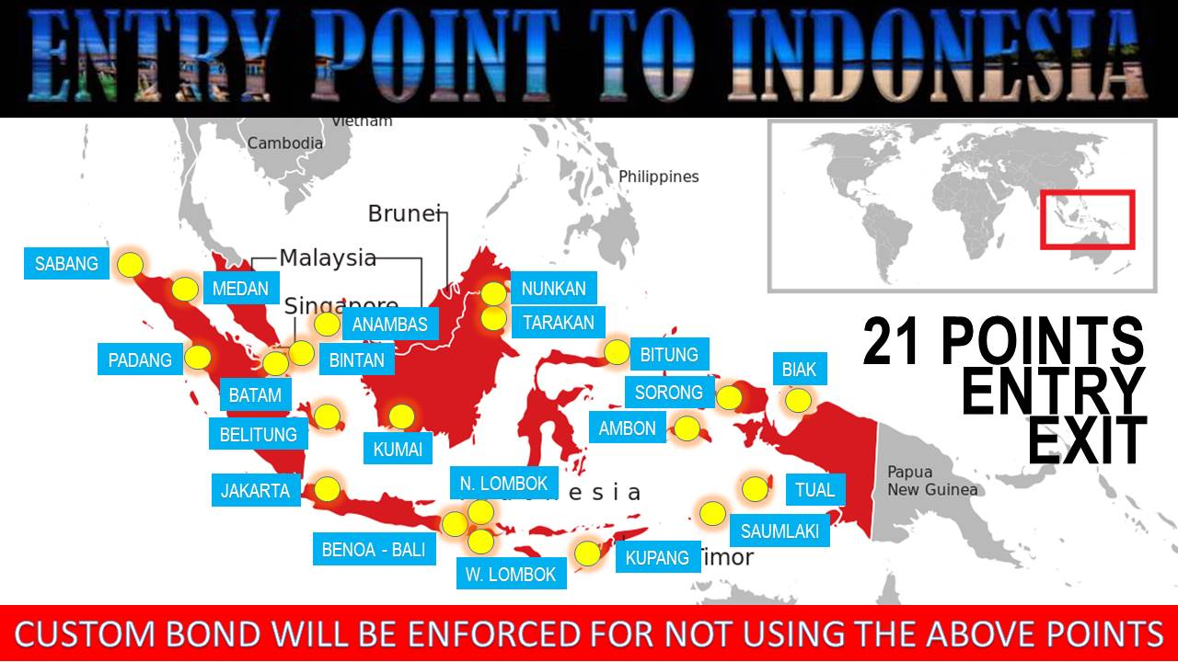

Slide 26
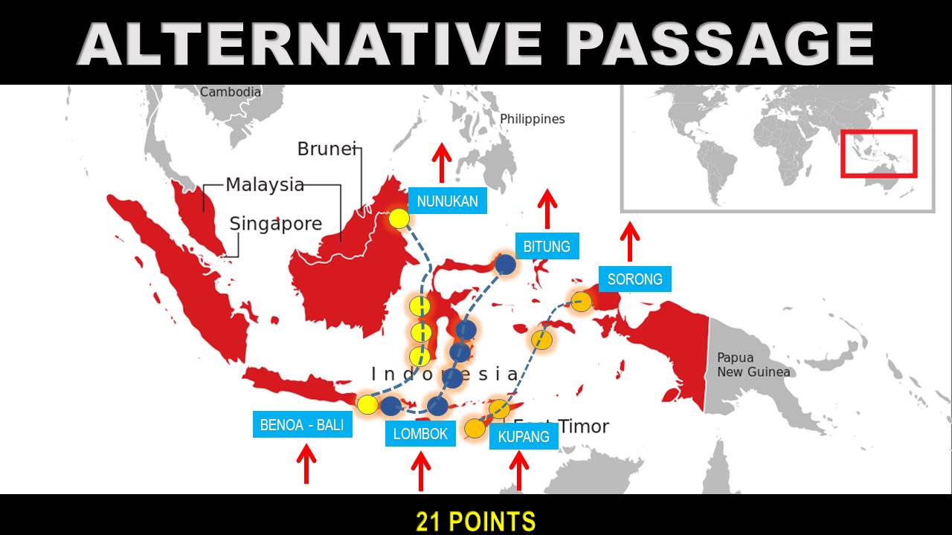
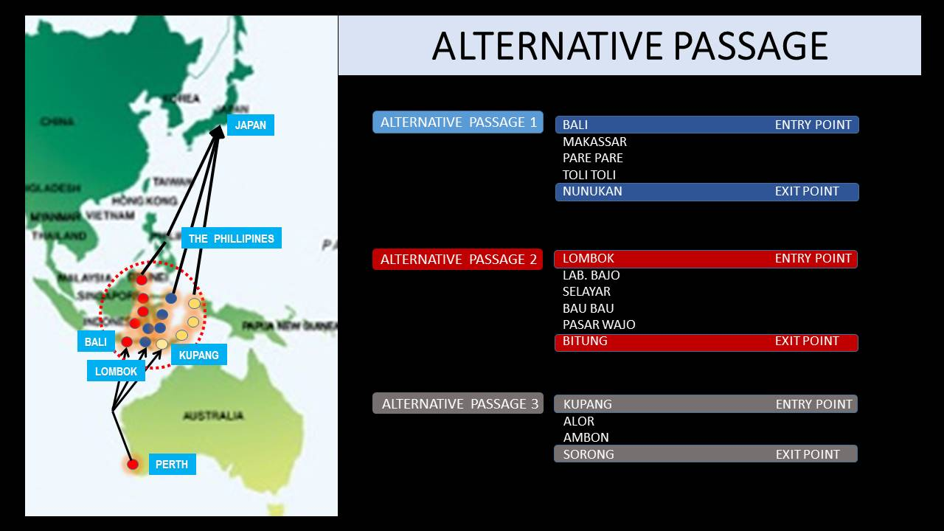

Slide 27
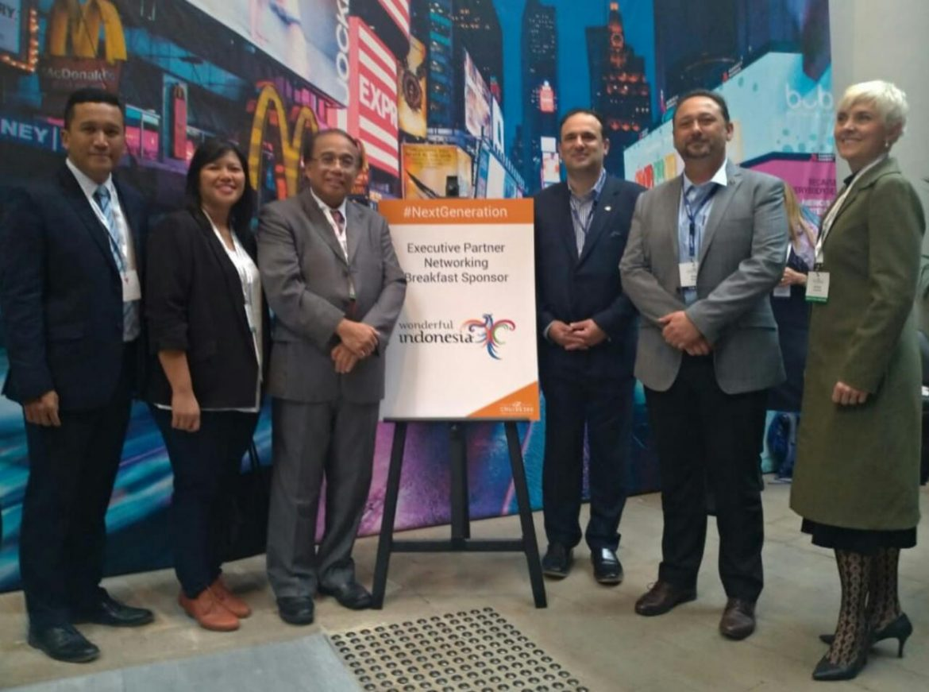
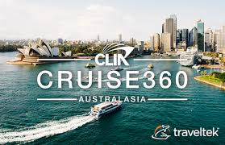
INDONESIA IS ATTENDING
TO THE CONFERENCE OF TOURISM VESSELS OF CLIA-360 CRUISE AUSTRALASIA
as an effort to spur the growth of the cruise ship industry in Indonesia

Slide 28
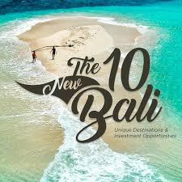
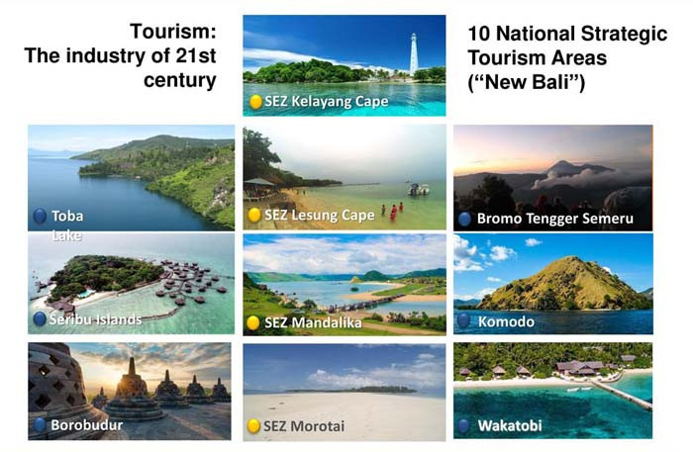
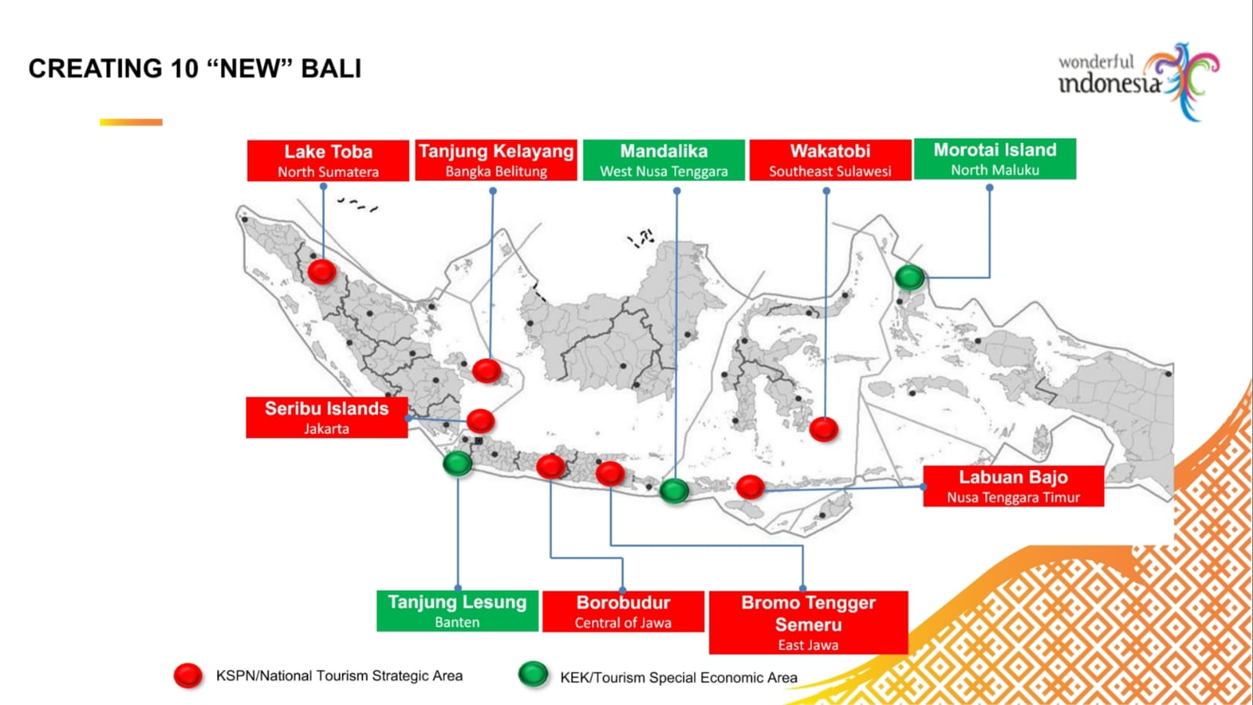

Slide 29
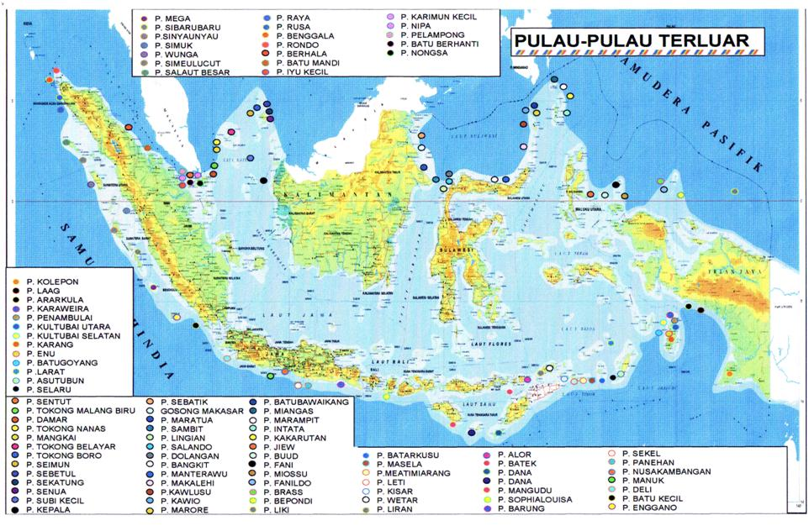
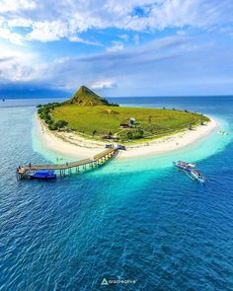
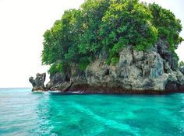

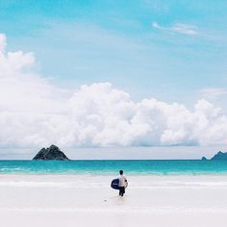
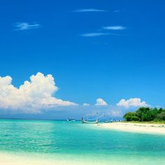
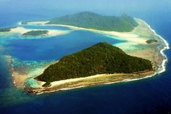
The Outer Islands
Presidential Decree
Number 6 of 2017
concerning the Determination of the Outer Islands
The Outer Islands
Establish 111 Islands as Outermost Islands

Slide 30
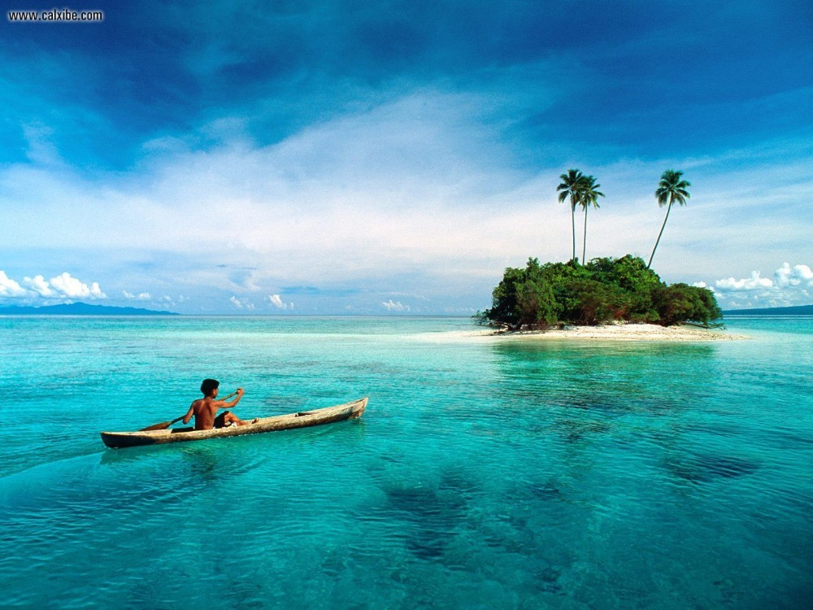
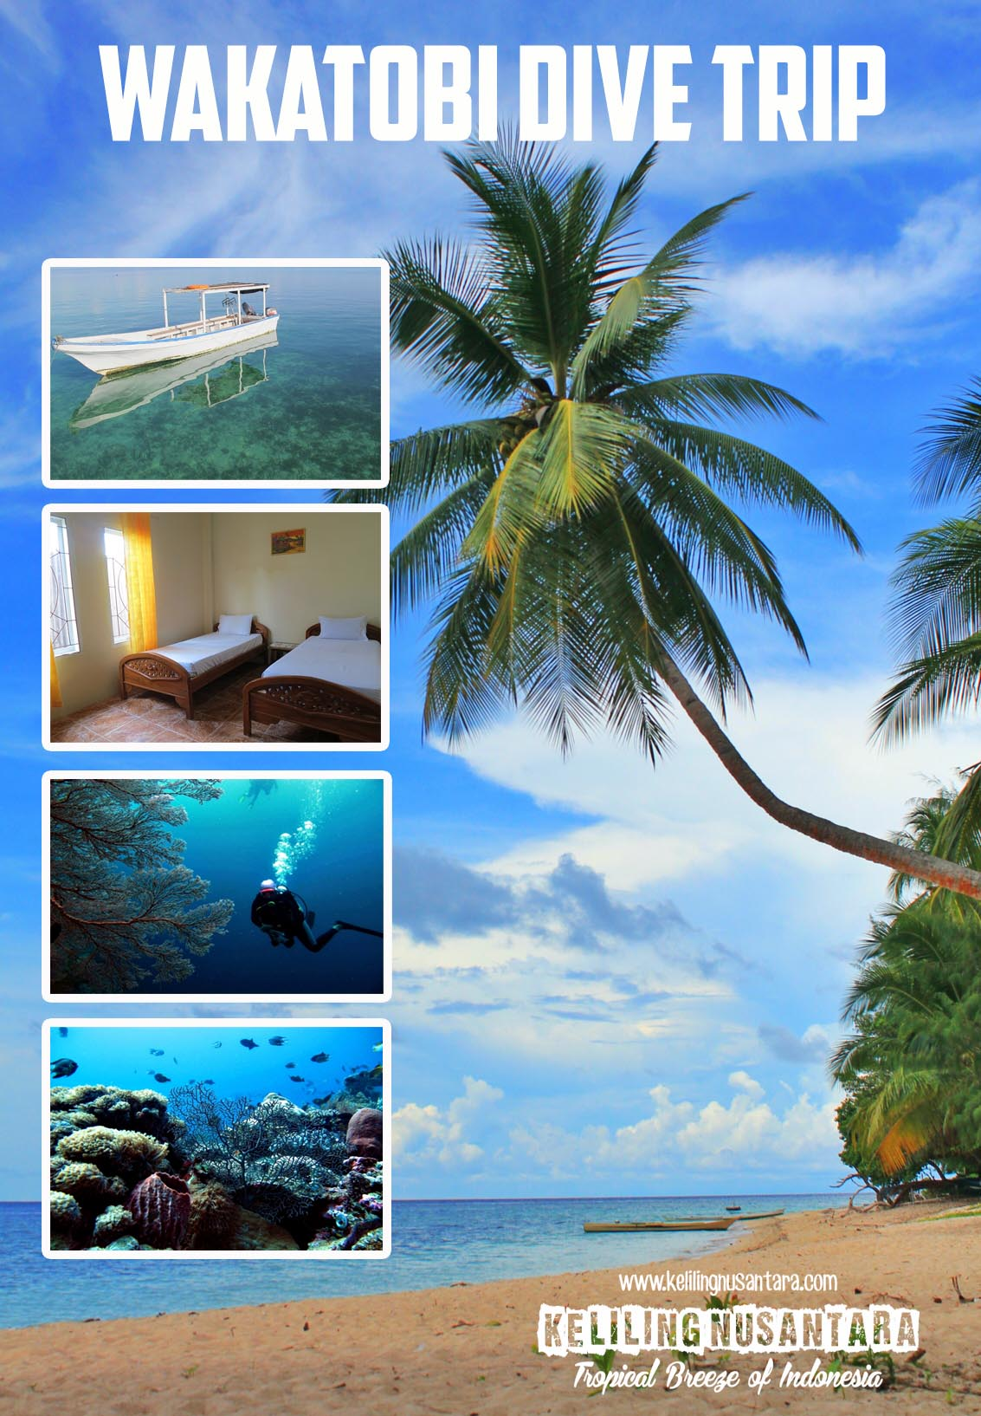


MARINE TOURISM
Small islands provide environmental services that have high economic value, namely as a region for ongoing tourism activities, communication media, recreation areas, conservation and other types of utilization
Types of tourism that can be developed in the area of ​​small islands
Marine Tourism
Terrestrial Tourism
Cultural Tourism
Lembata Whale Hunting
the traditional whale hunt of Lamalera on Flores Island

Slide 31


Build Indonesia
as a Maritime Country
Triple-C
C
C
C
Contour
Content
Conduct
The maritime approach
is not continental approach
Building infrastructure in the Central and Eastern Regions of Indonesia
Building the character of marine people; growing maritime awareness becomes the initial part of the maritime development code of conduct
This spatial review, contents and code of conduct as a maritime vision of the nation within the framework of the Archipelago Insight as the basis for national development

Slide 32


Slide 33
thank you for kind attention

